Slide 1
Programming Fundamentals
Lecture 5

Slide 2
Objectives
Cascading of << and >> operators
Boolean data type
Conditional structures
Logical OR & AND Operators
Multiple conditions in conditional structures
Nested conditional structures

Slide 3
Cascading in cout and cin
We have already seen that we can cascade the stream operator << in any C++ program, like
int a = 10, b = 20, c = 30;
cout<<a<<‘\t’<<b<<‘\t’<<c<<endl;
Similarly we can cascade the >> operator as well
The cascaded >> operator works for mixed data types, or we introduce dummy characters to such mixing
The benefit of cascading >> operator is, there will be no need to press the Enter key after typing every input
Have a look at the example for more clear understanding

Slide 4
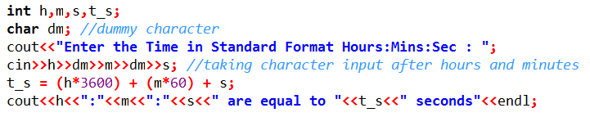
Practice Problem
Ask the user to enter the time in standard format like
Hours : Minutes : Seconds
And then calculate and display the total number of seconds
The user will enter the input in a single line and will press the enter key only once

Slide 5

Practice Problem
To find a vector between two points we use the relation:
And can also be written as:
Where x_{A}, y_{A}, z_{A} are the coordinates of point A, and x_{B}, y_{B}, z_{B} are the coordinates of point B.
So write an efficient C++ program which will take the two points from user, and then find the vector between them. The interface with user must look like this:
User will enter the data including the brackets and commas, and the output will be displayed as shown above.

Slide 6
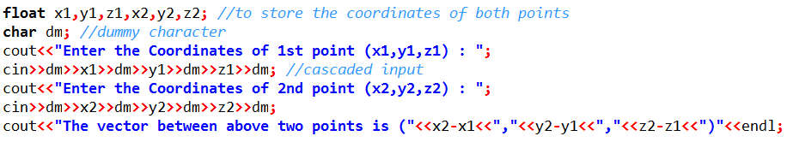
Practice Problem (Solution)
To find the vector between two point entered by user

Slide 7
bool Data Type
Variables of type bool can have only two possible values: true and false
bool can be declared by using the keyword “bool”
bool a;
How much memory is allocated to a?
1 bit
1 byte
In theory a bool type requires only one bit, but in compilers they consume 1 byte. Why?
A byte can be quickly accessed, while an individual bit must be extracted from a byte, which requires additional time. That is why in compilers the bool type consumes 1 byte

Slide 8
Using cin and cout with bool
The cin and cout can be used in the same syntax with bool, as we have done with other data types
There is little bit difference in values input and output
bool x = 45, y = 1, z = -18;
cout<<x<<‘\t’<<y<<‘\t’<<z<<endl;
The above statement will display 1 for x, y and z because bool can hold only 0 and 1, and all non-zero values will be taken as 1
If you store the values other than 0 and 1 in bool, then it will set the error flag

Slide 9
Using cin and cout with bool
We have seen that if we store the values other than 0 and 1 in bool, then it will set the error flag
If the error flag is set then the next bool input will be taken as 0
So while using cin with bool, we need to restrict the user to type only 0 and 1
Or we can use the cin.clear() function that clears the error flag
The use of cin.clear() is more easy, because restricting the user will be involving conditional and iterative structures

Slide 10
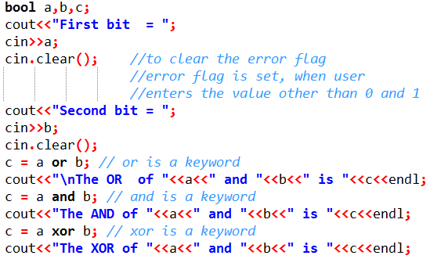
Practice Problem
Write a C++ code to implement the OR, AND and XOR gates. The user will enter two bits and code will compute the result of OR, AND and XOR

Slide 11
Decision Making in C++
Sometimes programs need to make some one-time decisions
Decision causes a onetime jump to a different part of the program, depending on the value of an expression
Decisions can be made in C++ in several ways. The most important is with the conditional structure (if – else if – else)
We can use the conditional statement as single if, if-else or if - else if - else

Slide 12
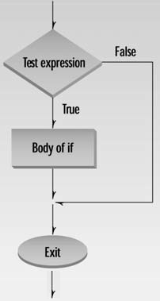
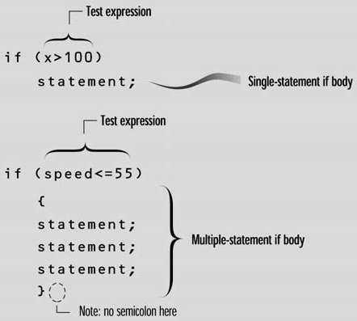
Conditional Structures
if statement
Single entry/single exit statement
The if statement lets you do something if a condition is true. If it isn’t true, nothing happens

Slide 13
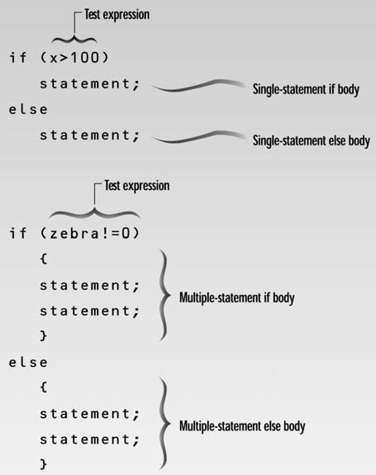
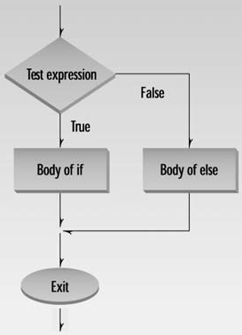
Conditional Structures
if .. else statement
Can be used to execute some other instruction if condition in “if” is not matched
Why we don’t use two ifs instead of if-else?
it is inefficient, because the compiler will be checking two conditions instead of one

Slide 14
Conditional Structures
Nested if .. else statements
We can have more ifs inside an if-else structure
But it is important to match the else with correct if
See the example code for possible errors
Here is the rule: An else is matched with the last if that doesn’t have its own else
It is better to use curly brackets for clarity and avoiding possible logical errors

Slide 15
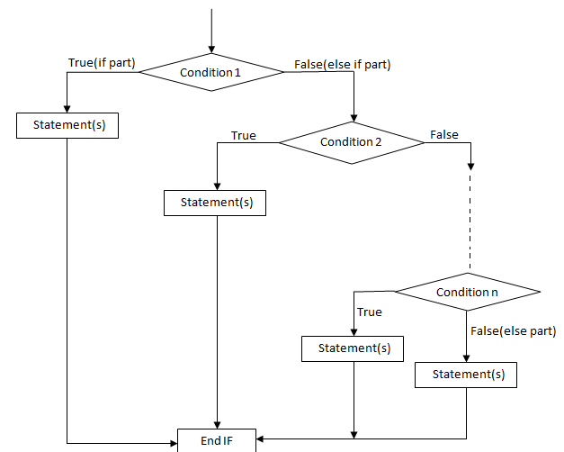
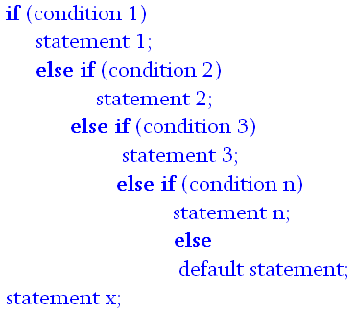
Conditional Structures
else if statement
Can be used for multiple comparisons and executions

Slide 16
Conditional Structure
While using if..else if..else statements keep the following points in mind
An if can have zero or one else's and it must come after any else if's
An if can have zero to many else if's and they must come before the else
Once an else if succeeds, none of the remaining else if's or else's will be tested

Slide 17
Logical OR & AND Operators in C++
Logical OR is coded as || in C++
Logical AND is coded as && in C++
|| and && operators are used to implement multiple conditions inside if or else if statement
For example if we want to make a decision when the value of variable is between 4 and 8, then we need to used || or && operator

Slide 18
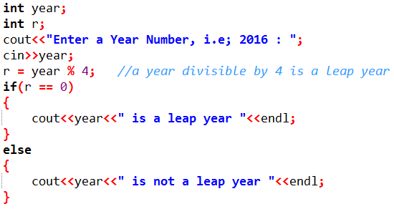
Task 1
Write a C++ program which should take a year as an input and tells the user either it is a leap year or not

Slide 19
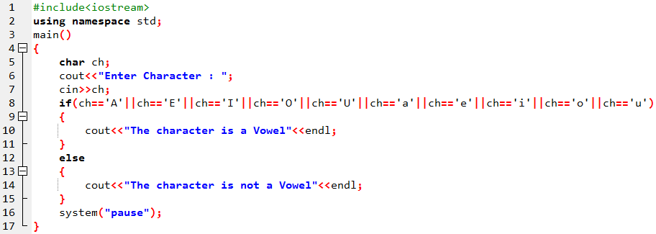
Task 2
Write a code to find out whether the number entered by the user is vowel or not.

Slide 20
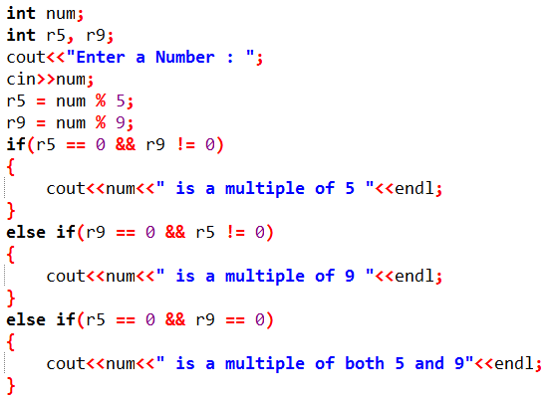
Task 3
Write a C++ code which should ask the user to enter an integer and then tells that either the number is a multiple of 5, 9 or both of them.

Slide 21
Task 4
Write a C++ program which should ask the user to enter a character and tells that, either it is an upper case, lower case, number or a special character.
Type ASCII Range
Digits (0 – 9) 48 – 57
Upper Case Letters (A – Z) 65 – 90
Lower Case Letters (a – z) 97 – 122
Special Characters 0-47, 58-64, 91-96, 123-127
Solution on Next Slide

Slide 22
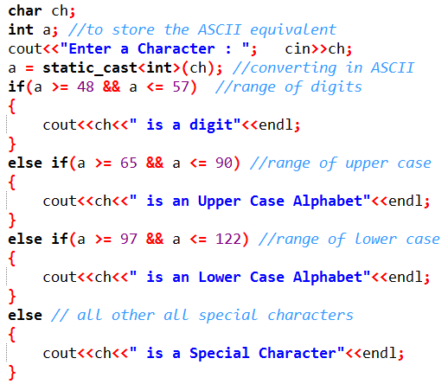
Task 4 Solution

